Slide 1
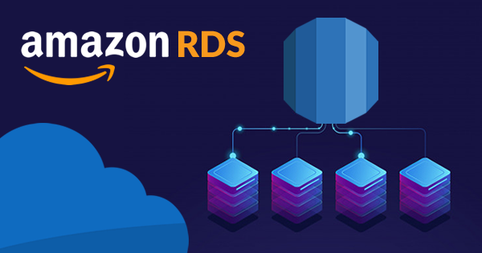

Slide 2

Topics
What is Relational Databases Service (RDS)
Multi-AZ vs Read Replicas
What is Non-Relational Databases
What is Data Warehousing?
OLTP vs OLAP
What is ElastiCache?
Exam Tip

Slide 3

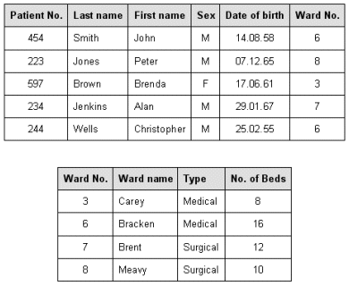

What is a Relational Databases (RDS)?
Relational databases are what most of us are all used to. They have been around since the 70’s.
Think of traditional spreadsheet:
Databases
Table
Row

Slide 4
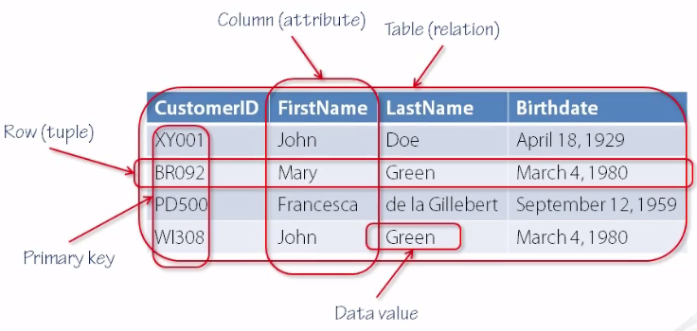
What is a Relational Databases (RDS)?

Slide 5
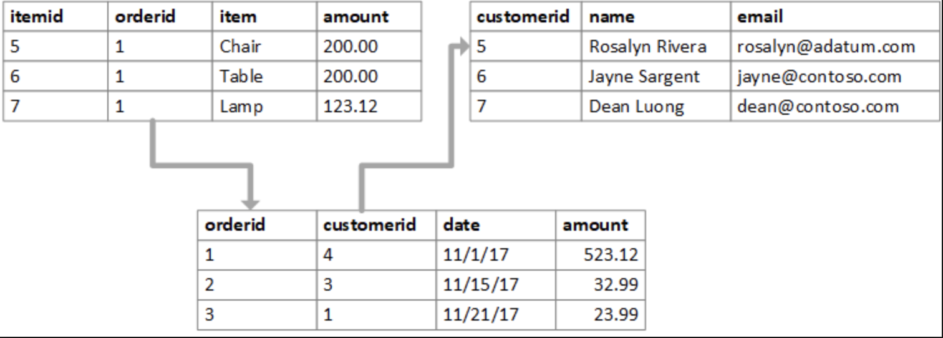
What is a Relational Databases (RDS)?

Slide 6

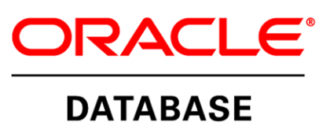




Relational databases on AWS
Amazon Relational Database Service (Amazon RDS) is a managed service that makes it easy to set up, operate, and scale a relational database in the cloud.
It provides cost-efficient and resizable capacity, while managing time-consuming database administration tasks, freeing you up to focus on your applications and business
SQL Server
Oracle
MySQL Server
Postgre SQL
Aurora
MariaDB

Slide 7


Multi-AZ vs Read Replicas
RDS has two key features
Multi-AZ :- For Disaster Recovery
Read Replicas :- For Performance

Slide 8
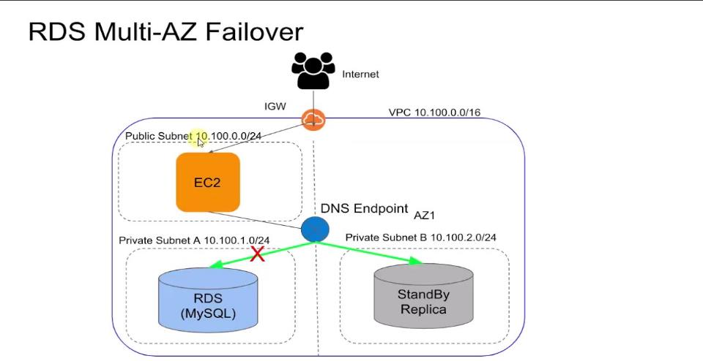
Multi-AZ

Slide 9
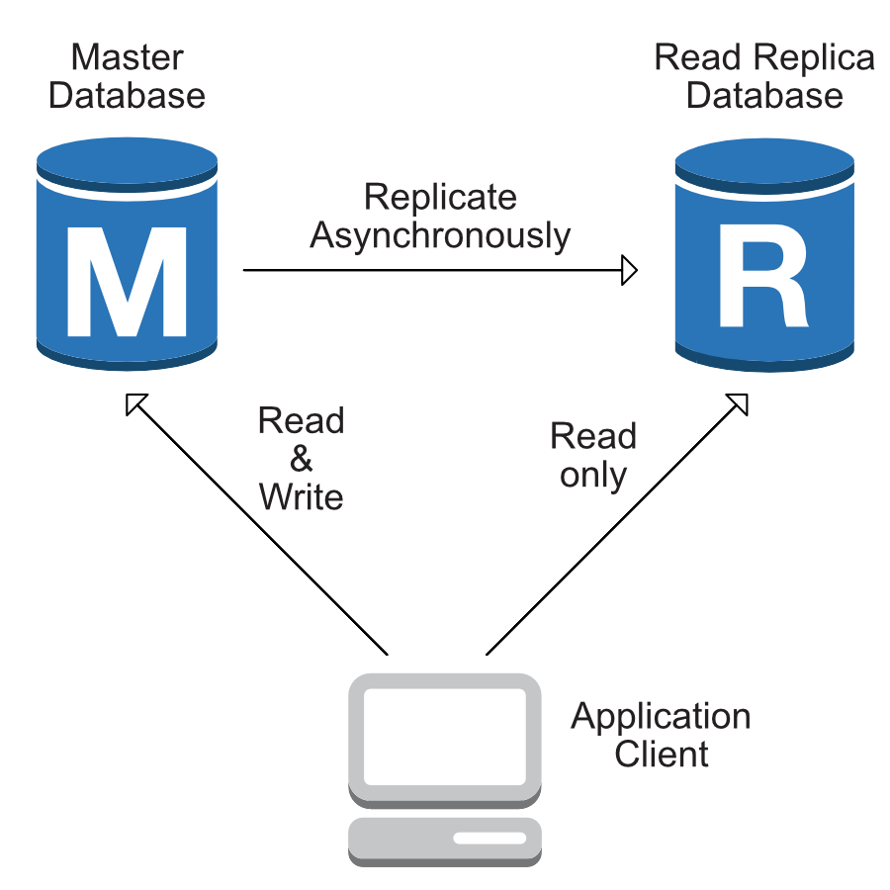
Read Replicas

Slide 10
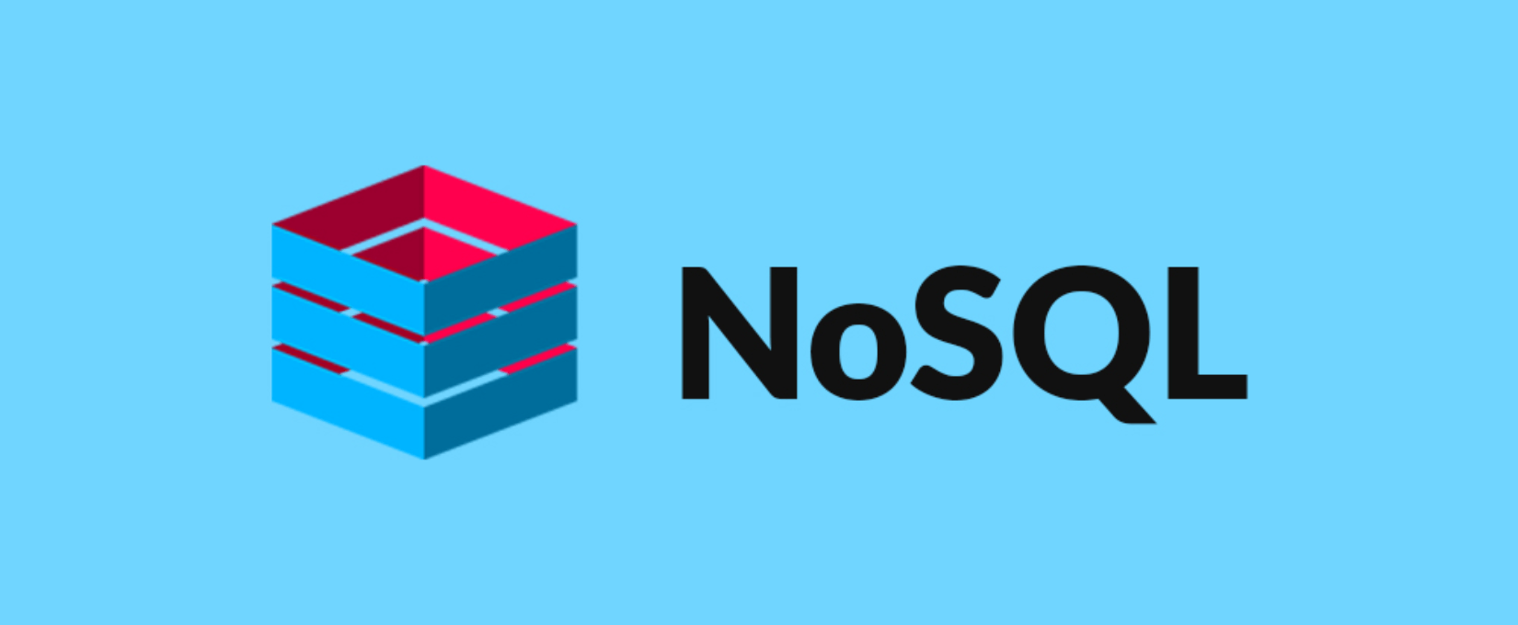
Non-Relational Databases
Collection - table
Document - Row
Key Value Pairs - Fields
AWS DynamoDB is Non-SQL Database

Slide 11
Non-Relational Databases
{
"id": "9923810800391",
"firstname": "sanjay",
"surname": "gupta",
"age": "23",
"address": [
{
"street": "f-7 sujata flat",
"suburb": "sahi bag",
"city": "ahmedabad",
"pincode": "293772"
}
]
}

Slide 12
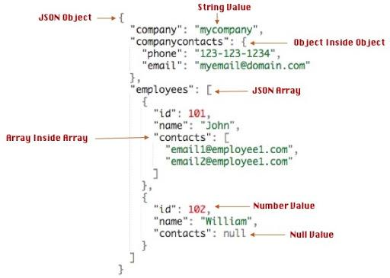
Non-Relational Databases

Slide 13
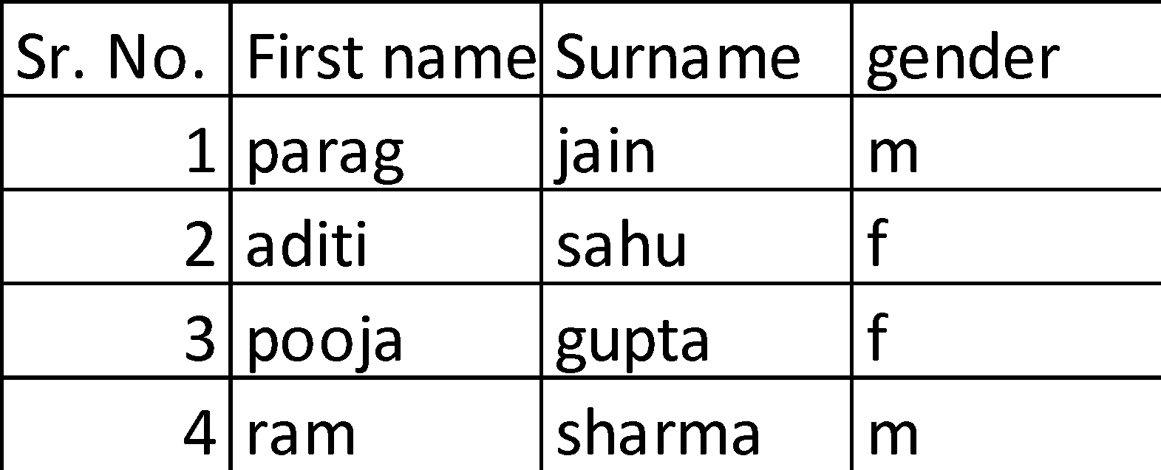
What is a Relational Databases (RDS)?

Slide 14
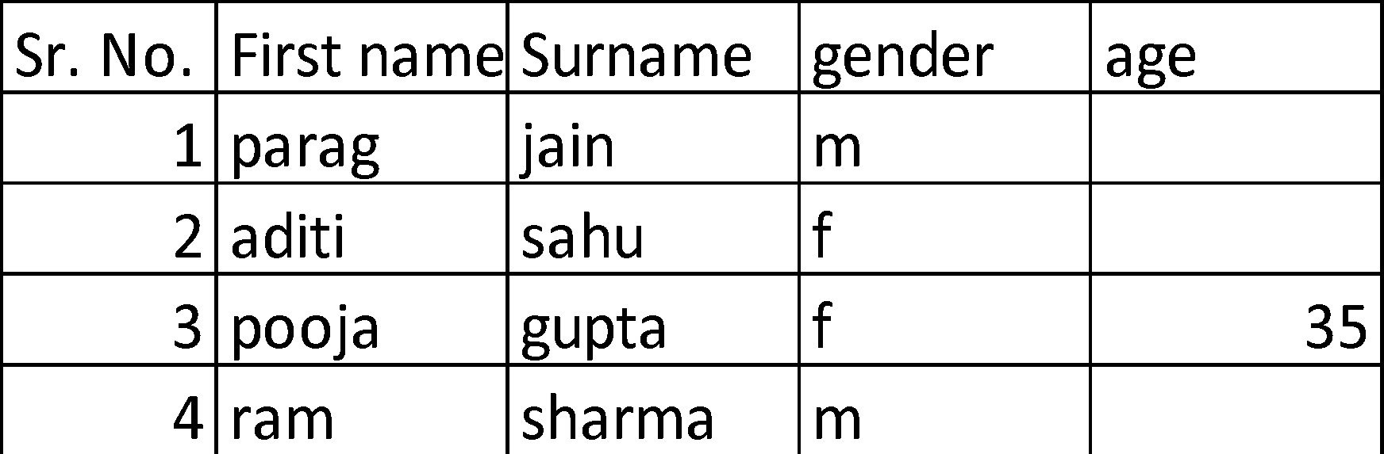
What is a Relational Databases (RDS)?

Slide 15


What is Data Warehousing?
Used for business intelligence. Tools like Cognos, Jaspersoft, SQL Server Reporting Services, Oracle Hyperion, SAP NetWeaver.
Used to pull in very large and complex data sets. Usually used by management to do queries on data (such as current performance vs targets etc)

Slide 16

OLTP vs OLAP
Online Transaction Processing (OLTP) differs from OLAP online Analytics Processing (OLAP) in terms of types of queries you will run.
OLTP Example:
Order number 123123, Pulls up a row of data such as Name, Date, Address to deliver to, Delivery Status, etc

Slide 17

OLTP vs OLAP
OLAP transaction Example:
Net Profit for EMEA and pacific for Digital Radio Product
Pulls in large numbers of records
Sum of Radios Sold in EMEA
Sum of Radios Sold in Pacific
Unit Cost of Radio in each region
Sales price of each radio
Sale price - unit cost

Slide 18
OLTP vs OLAP
Data Warehousing databases use different type of architecture both from a databases perspective and infrastructure layer.
Amazon's Data Warehouse Solution is called Redshift

Slide 19
What is ElastiCache?
ElastiCache is web service that makes it easy to deploy, operate and scale an in-memory cache in the cloud.
The service improve the performance of web application by allowing you to retrieve information from fast, managed, in-memory caches, instead of relying entirely on slower disk-based databases
ElastiCache supports two open-source in-memory caching engines.
Memcached
Redis

Slide 20
Exam Tips:
RDS(OLTP)
SQL
MySQL
PostgreSQL
Oracle
Aurora
MariaDB
DynamoDB(NO SQL)
RedShift(OLAP)
RedShift for business intelligence or data Warehousing

Slide 21
Exam Tips:
ElastiCache:
ElastiCache to speed up performance of existing database (frequent identical queries)
Memcached
Redis

Slide 22
Thank you

